Slide 1
Contents
Introduction and Agents (chapters 1,2)
Search (chapters 3,4,5,6)
Logic (chapters 7,8,9)
Planning (chapters 11,12)
Uncertainty (chapters 13,14, 15)
Learning (chapters 18,20)
Natural Language Processing (chapter 22,23)

Slide 2
Uncertainty
Chapter 13

Slide 3
Outline
Uncertainty
Probability
Syntax and Semantics
Inference
Independence and Bayes' Rule

Slide 4
Uncertainty
Event: A_{t} = leave for airport t minutes before flight
Question： Will A_{t} get me there on time?
Problems:
  partial observability (road state, other drivers' plans, etc.)
  noisy sensors (traffic reports)
  uncertainty in action outcomes (flat tire, car accident etc.)
  immense complexity of modeling and predicting traffic
Hence a purely logical approach either
  risks falsehood: “A₂₅ will get me there on time”, or
  leads to conclusions that are too weak for decision making:
“A₂₅ will get me there on time if there's no accident on the bridge and it doesn't rain and my tires remain intact etc etc.”

Slide 5
Methods for handling uncertainty
Default or nonmonotonic logic:
  Assume my car does not have a flat tire
  Assume A₂₅ works unless contradicted by evidence
Issues: What assumptions are reasonable? How to handle contradiction?
Rules with fudge factors:
  A₂₅ |→_{0.3} get there on time
  Sprinkler |→ _{0.99} WetGrass
  WetGrass |→ _{0.7} Rain
Issues: Problems with combination, e.g., Sprinkler causes Rain??
Probability
  Model agent‘s degree of belief, given the available evidence,
  A₂₅ will get me there on time with probability 0.04

Slide 6
Probability
Probabilistic assertions summarize effects of
  laziness: need not enumerate exceptions, qualifications, etc.
  ignorance: lack of relevant facts, initial conditions, etc.
    Theoretical ignorance: Medical science has no complete theory for the domain.
    Practical ignorance: Even if we know all the rules, we might be uncertain about a particular patient because not all the necessary tests have been or can be run.
degree of belief
Notes:
Gum Disease 牙周炎 Abscess 脓肿

Slide 7
Probability
Probability provides a way of summarizing the uncertainty that comes from our laziness and ignorance.
Subjective probability:
  Probabilities relate propositions to agent's own state of knowledge
e.g., P(A₂₅ | no reported accidents) = 0.06
  These are not assertions about the world
  Probabilities of propositions change with new evidence:
e.g., P(A₂₅ | no reported accidents, 5 a.m.) = 0.15

Slide 8
Making decisions under uncertainty
Suppose I believe the following:
  P(A₂₅ gets me there on time | …) = 0.04
  P(A₉₀ gets me there on time | …) = 0.70
  P(A₁₂₀ gets me there on time | …) = 0.95
  P(A₁₄₄₀ gets me there on time | …) = 0.9999
Which action to choose?
Depends on my preferences for missing flight vs. time spent waiting, etc.
  Utility theory is used to represent and infer preferences
  Decision theory = probability theory + utility theory

Slide 9
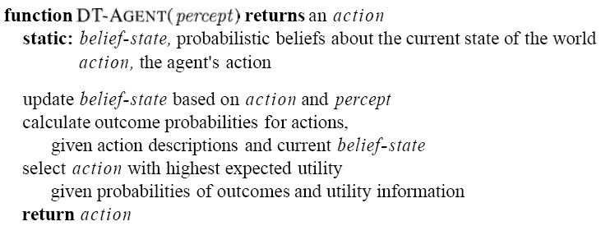
Making decisions under uncertainty

Slide 10
Syntax
Basic element: random variable
Similar to propositional logic: possible worlds defined by assignment of values to random variables.
Boolean random variables
  e.g., Cavity (do I have a cavity?)
Discrete random variables
  e.g., Weather is one of <sunny,rainy,cloudy,snow>
  Domain values must be exhaustive and mutually exclusive
Elementary proposition constructed by assignment of a value to a random variable:
  e.g., Weather = sunny, Cavity = false (abbreviated as ¬cavity)
Complex propositions formed from elementary propositions and standard logical connectives
  e.g., (Weather = sunny) ∨ (Cavity = false)

Slide 11
Syntax
Atomic event: A complete specification of the state of the world about which the agent is uncertain
  E.g., if the world consists of only two Boolean variables Cavity and Toothache, then there are 4 distinct atomic events:
    Cavity = false ∧Toothache = false
    Cavity = false ∧ Toothache = true
    Cavity = true ∧ Toothache = false
    Cavity = true ∧ Toothache = true
Atomic events are mutually exclusive and exhaustive

Slide 12
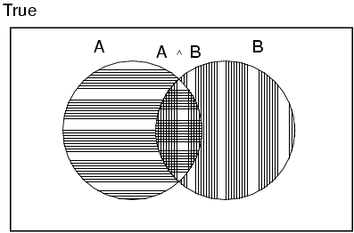
Axioms of probability
For any propositions A, B
  0 ≤ P(A) ≤ 1
  P(true) = 1 and P(false) = 0
  P(A ∨ B) = P(A) + P(B) - P(A ∧ B)

Slide 13
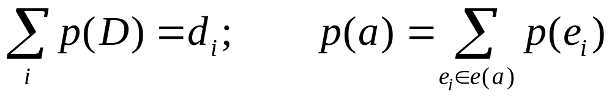
Using the axioms of probability
P(a⋁¬a ) = P(a) + P (¬ a ) - P(a⋀¬a )
(by axiom 3 with b = ¬ a )
P(true) = P(a) + P (¬a ) - P(false)
(by logical equivalence)
1 = P(a) + P (¬a ) (by axiom 2)
P (¬a ) = 1 - P(a) (by algebra).

Slide 14

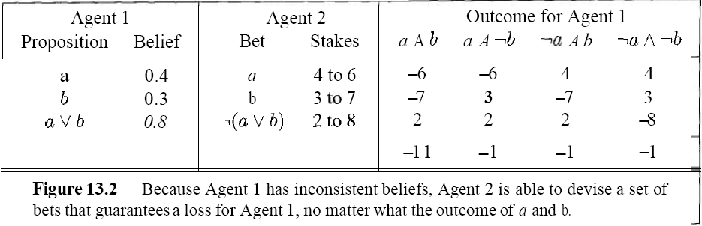
The axioms of probability are reasonable
If Agent 1 expresses a set of degrees of belief that violate the axioms of probability theory then there is a combination of bets by Agent 2 that guarantees that Agent 1 will lose money every time.

Slide 15
Prior probability
Prior or unconditional probabilities of propositions
  e.g., P(Cavity = true) = 0.1 and P(Weather = sunny) = 0.72 correspond to belief prior to arrival of any (new) evidence
Probability distribution gives values for all possible assignments:
  P(Weather) = <0.72,0.1,0.08,0.1> (normalized, i.e., sums to 1)
Joint probability distribution for a set of random variables gives the probability of every atomic event on those random variables
  P(Weather,Cavity) = a 4 × 2 matrix of values:
Weather = sunny rainy cloudy snow
Cavity = true 0.144 0.02 0.016 0.02
Cavity = false 0.576 0.08 0.064 0.08
Every question about a domain can be answered by the joint distribution

Slide 16
Conditional probability
Conditional or posterior probabilities
  e.g., P(cavity | toothache) = 0.8
  i.e., given that toothache is all I know
(Notation for conditional distributions:
  P(Cavity | Toothache) = 2-element vector of 2-element vectors)
If we know more, e.g., cavity is also given, then we have
  P(cavity | toothache,cavity) = 1
New evidence may be irrelevant, allowing simplification, e.g.,
  P(cavity | toothache, sunny) = P(cavity | toothache) = 0.8

Slide 17
Conditional probability
Definition of conditional probability:
  P(a | b) = P(a ∧ b) / P(b) if P(b) > 0
Product rule gives an alternative formulation:
  P(a ∧ b) = P(a | b) P(b) = P(b | a) P(a)
A general version holds for whole distributions, e.g.,
  P(Weather,Cavity) = P(Weather | Cavity) P(Cavity)
(View as a set of 4 × 2 equations, not matrix mult.)
Chain rule is derived by successive application of product rule:
  P(X₁, …,X_{n}) = P(X₁,...,X_{n-1}) P(X_{n} | X₁,...,X_{n-1})
  = P(X₁,...,X_{n-2}) P(X_{n-1} | X₁,...,X_{n-2}) P(X_{n} | X₁,...,X_{n-1})
  = …
  = П_{i= 1}^n P(X_{i} | X₁, … ,X_{i-1})

Slide 18

Inference by enumeration
Start with the joint probability distribution:
For any proposition φ, sum the atomic events where it is true: P(φ) = Σ_{ω:ω╞φ} P(ω)

Slide 19

Inference by enumeration
Start with the joint probability distribution:
For any proposition φ, sum the atomic events where it is true: P(φ) = Σ_{ω:ω╞φ} P(ω)
P(toothache) = 0.108 + 0.012 + 0.016 + 0.064 = 0.2

Slide 20

Inference by enumeration
Start with the joint probability distribution:
Can also compute conditional probabilities:
P(¬cavity | toothache) = P(¬cavity ∧ toothache)
P(toothache)
= 0.016+0.064
0.108 + 0.012 + 0.016 + 0.064
= 0.4

Slide 21
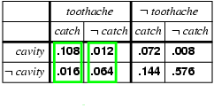
Normalization
Denominator can be viewed as a normalization constant α
P(Y | X)= P(X ,Y)/P(Y)= α P(X , Y)
P(Cavity | toothache) = α P(Cavity,toothache)
  = α [P(Cavity,toothache,catch) + P(Cavity,toothache,¬ catch)]
  = α [<0.108,0.016> + <0.012,0.064>]
  = α <0.12,0.08> = <0.6,0.4>
General idea: compute distribution on query variable by fixing evidence variables and summing over hidden variables

Slide 22
Inference by enumeration
Typical Problem:
Given evidence variables E=e, estimate the posterior joint distribution of the query variables Y
Let the hidden variables be H,
  P(Y | E = e) = α P(Y,E = e) = α Σ_{h} P(Y, E= e, H = h)
Obvious problems:
  Worst-case time complexity O(d^{n}) where d is the largest arity
  Space complexity O(d^{n}) to store the joint distribution
  How to find the numbers for O(d^{n}) entries?

Slide 23
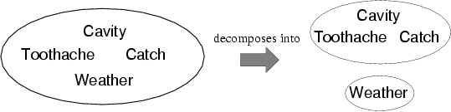
Independence
A and B are independent iff
P(A|B) = P(A) or P(B|A) = P(B) or P(A, B) = P(A) P(B)
  P(Toothache, Catch, Cavity, Weather)
  = P(Toothache, Catch, Cavity) P(Weather)
32 entries reduced to 12; for n independent biased coins,
O(2^{n}) →O(n)
Absolute independence powerful but rare
Dentistry is a large field with hundreds of variables, none of which are independent. What to do?

Slide 24
Conditional independence
P(Toothache, Cavity, Catch) has 2³ – 1 = 7 independent entries
If I have a cavity, the probability that the probe catches in it doesn't depend on whether I have a toothache:
  (1) P(catch | toothache, cavity) = P(catch | cavity)
The same independence holds if I haven't got a cavity:
  (2) P(catch | toothache,¬cavity) = P(catch | ¬cavity)
Catch is conditionally independent of Toothache given Cavity:
  P(Catch | Toothache,Cavity) = P(Catch | Cavity)
Equivalent statements:
  P(Toothache | Catch, Cavity) = P(Toothache | Cavity)
  P(Toothache, Catch | Cavity) = P(Toothache | Cavity) P(Catch | Cavity)

Slide 25
Conditional independence
Write out full joint distribution using chain rule:
P(Toothache, Catch, Cavity)
  = P(Toothache | Catch, Cavity) P(Catch, Cavity)
  = P(Toothache | Catch, Cavity) P(Catch | Cavity) P(Cavity)
  = P(Toothache | Cavity) P(Catch | Cavity) P(Cavity)
I.e., 2 + 2 + 1 = 5 independent numbers
In most cases, the use of conditional independence reduces the size of the representation of the joint distribution from exponential in n to linear in n.
Conditional independence is our most basic and robust form of knowledge about uncertain environments.

Slide 26
Bayes' Rule
Bayes' rule
P(Y|X) = P(X|Y) P(Y) / P(X) = αP(X|Y) P(Y)
Useful for assessing diagnostic probability from causal probability:
  P(Cause|Effect) = P(Effect|Cause) P(Cause) / P(Effect)
  E.g., let M be meningitis, S be stiff neck:
  We know:
  P(s|m)=0.5; P(m)=1/5000; P(s)=1/20;
  Query:
    P(m|s) = P(s|m) P(m) / P(s) = 0.8 × 0.0001 / 0.1 = 0.0008
  Note: posterior probability of meningitis still very small!

Slide 27
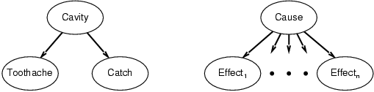
Bayes' Rule and conditional independence
P(Cavity | toothache ∧ catch)
  = α P(toothache ∧ catch | Cavity) P(Cavity)
  = α P(toothache | Cavity) P(catch | Cavity) P(Cavity)
This is an example of a naïve Bayes model:
P(Cause,Effect₁, … ,Effect_{n}) = P(Cause) П_{i}P(Effect_{i}|Cause)
Total number of parameters is linear in n

Slide 28
Summary
Probability is a rigorous formalism for uncertain knowledge
Joint probability distribution specifies probability of every atomic event
Queries can be answered by summing over atomic events
Independence and conditional independence provide the basic tools to reduce the joint size

Slide 29


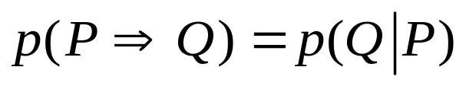
Class Exercise
  Using the axioms of probability, prove
  Given Bayesian Network
  Calculate
  In what condition,
P p(P)
Q p(Q|P), p(Q| ﹁ P)

